Slide 1
Project Management and SE Context
SE423: Software Project Management

Slide 2
Outline
Introduction
Projects
What is Project Management?
Software Project Management
Factors in Project Success & Failure
Project Dimensions
Projects vs Programs
Suggested Skills for PM
Project Management History

Slide 3
Introduction

Slide 4
Learning Objectives (1 of 2)
Define the systems view of project management and how it applies to information technology (IT) projects
Summarize organizations, including the four frames, organizational structures, and organizational culture
Explain why stakeholder management and top management commitment are critical for a project’s success

Slide 5
Learning Objectives (2 of 2)
Distinguish between project and product life cycles
Discuss the unique attributes and diverse nature of IT projects
Summarize recent trends affecting IT project management, including globalization, outsourcing, virtual teams, and agile project management

Slide 6
A Systems View of Project Management
Projects must operate in a broad organizational environment
Project managers need to use systems thinking:
Taking a holistic view of carrying out projects within the context of the organization

Slide 7
What Is a Systems Approach?
A systems approach emerged in the 1950s to describe a holistic and analytical approach to management and problem solving
Three parts include:
Systems philosophy: an overall model for thinking about things as systems
Systems analysis: problem-solving approach
Systems management: address business, technological, and organizational issues before making changes to systems

Slide 8
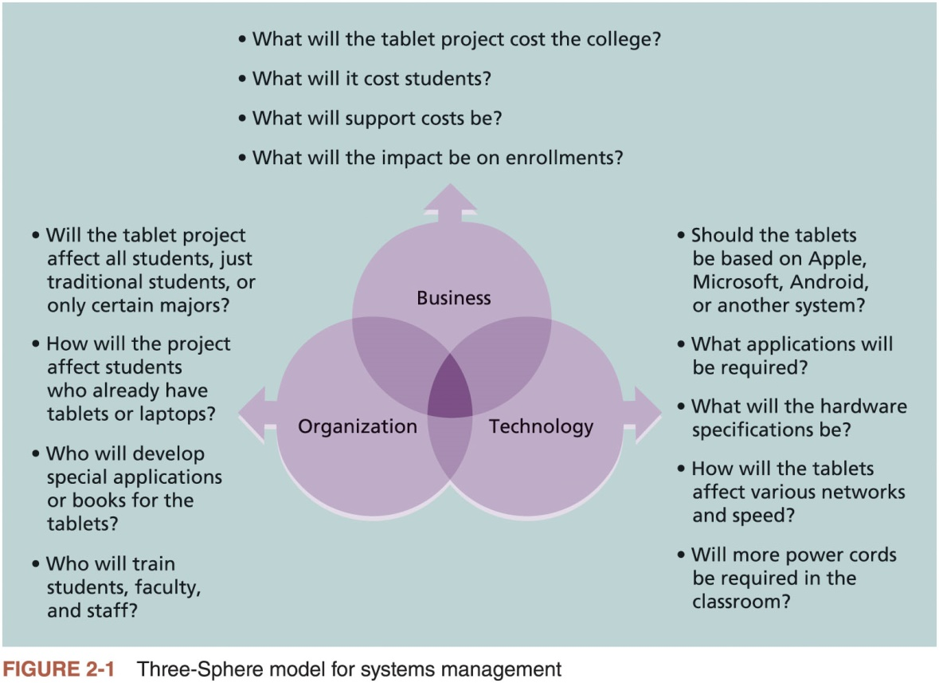
The Three-Sphere Model for Systems Management

Slide 9
Advice for Young Professionals
It’s difficult enough trying to understand the various technologies an organization uses. How can you begin to understand the business and organizational aspects?
Make it a priority. Don’t just focus on the technology, no matter how exciting it seems to you. Even if you take just a few minutes each day learning about other aspects of the organization, that’s a start.
Tell your boss or other people you work with that you want to understand how the entire organization works. Ask important questions like how the company makes money, who key customers are, what the priorities are for the year, what meetings you can attend or documents you can read to gain more knowledge, etc.
Network, network, network! Find out which people inside or outside of your organization can help you in developing a systems approach. You might be surprised how quickly you can move up in your career once you understand the big picture.

Slide 10
Understanding Organizations
Systems approach requires that project managers always view their projects in the context of the larger organization
Organizational issues are often the most difficult part of working on and managing projects
Important for project managers to develop a better understanding of people as well as organizations
To improve the success rate of IT projects

Slide 11
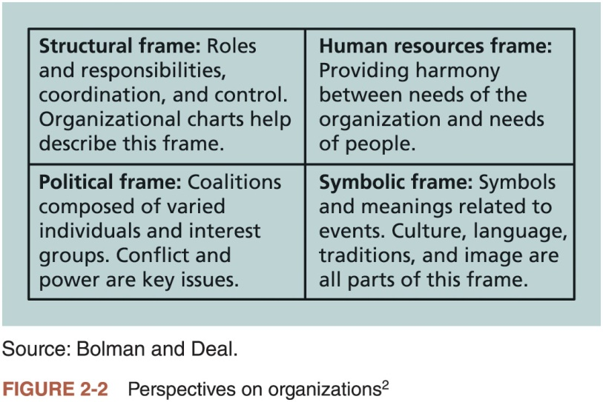
The Four Frames of Organizations

Slide 12
What Went Wrong?
In a paper titled “A Study in Project Failure,” two researchers examined the success and failure of 214 IT projects over an eight-year period in several European countries
The researchers found that only one in eight (12.5 percent) were considered successful in terms of meeting scope, time, and cost goals
The authors said that the culture within many organizations is often to blame
Among other things, people often do not discuss important leadership, stakeholder, and risk management issues

Slide 13
Organizational Structures (1 of 2)
Three basic organizational structures
Functional: functional managers report to the CEO
Project: program managers report to the CEO
Matrix: middle ground between functional and project structures; personnel often report to two or more bosses; structure can be weak, balanced, or strong matrix

Slide 14
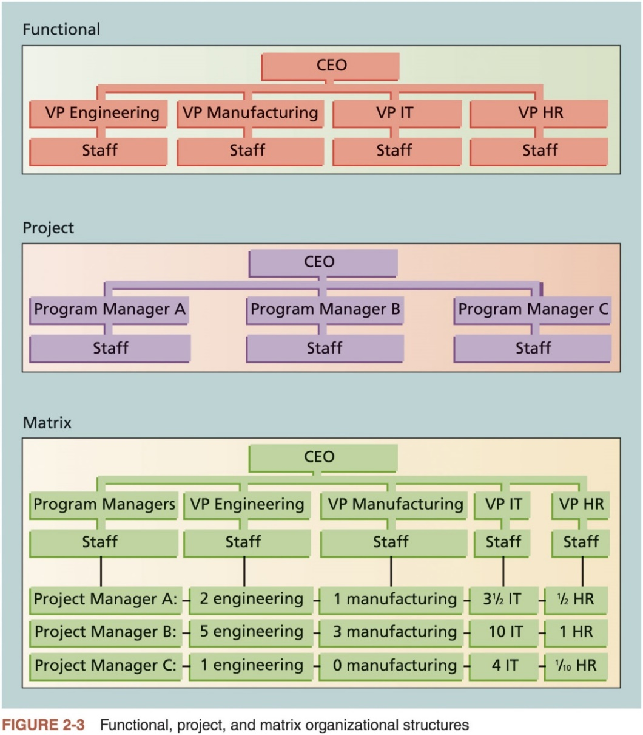
Organizational Structures (2 of 2)

Slide 15
Organizational Culture (1 of 2)
Organizational culture is a set of shared assumptions, values, and behaviors that characterize the functioning of an organization
Many experts believe the underlying causes of many companies’ problems are not the structure or staff, but the culture

Slide 16
Organizational Culture (2 of 2)
Ten characteristics of organizational culture:
Member identity*
Group emphasis*
People focus
Unit integration*
Control
Risk tolerance*
Reward criteria*
Conflict tolerance*
Means-ends orientation
Open-systems focus*
*Project work is most successful in an organizational culture where these items are strong/high and other items are balanced.

Slide 17
Focusing on Stakeholder Needs
Project managers must take time to identify, understand, and manage relationships with all project stakeholders
Using the four frames of organizations can help meet stakeholder needs and expectations
Senior executives/top management are very important stakeholders
See Chapter 13, Project Stakeholder Management, for more information

Slide 18
The Importance of Top Management Commitment
People in top management positions are key stakeholders in projects
A very important factor in helping project managers successfully lead projects is the level of commitment and support they receive from top management
Without top management commitment, many projects will fail.
Some projects have a senior manager called a champion who acts as a key proponent for a project.

Slide 19
The Importance of Top Management Commitment
How top management can help project managers
Providing adequate resources
Approving unique project needs in a timely manner
Getting cooperation from other parts of the organization
Mentoring and coaching on leadership issues

Slide 20
Best Practice
IT governance addresses the authority and control for key IT activities in organizations, including IT infrastructure, IT use, and project management
A lack of IT governance can be dangerous, as evidenced by three well-publicized IT project failures in Australia
Sydney Water’s customer relationship management system
The Royal Melbourne Institute of Technology’s academic management system
One.Tel’s billing system

Slide 21
The Need for Organizational Commitment to Information Technology
If the organization has a negative attitude toward IT, it will be difficult for an IT project to succeed
Having a Chief Information Officer (CIO) at a high level in the organization helps IT projects
Assigning non-IT people to IT projects also encourage more commitment

Slide 22
The Need for Organizational Standards
Standards and guidelines help project managers be more effective
Senior management can encourage
the use of standard forms and software for project management
the development and use of guidelines for writing project plans or providing status information
the creation of a project management office or center of excellence

Slide 23
Project and Product Life Cycles
It is good practice to divide projects into several phases
Because projects operate as part of a system and involve uncertainty
The same can be said for developing products

Slide 24
Project Life Cycle (1 of 2)
A project life cycle is a collection of project phases that defines
what work will be performed in each phase
what deliverables will be produced and when
who is involved in each phase, and
how management will control and approve work produced in each phase
A deliverable is a product or service produced or provided as part of a project

Slide 25
Project Life Cycle (2 of 2)
In early phases of a project life cycle
resource needs are usually lowest
the level of uncertainty (risk) is highest
project stakeholders have the greatest opportunity to influence the project
In middle phases of a project life cycle
the certainty of completing a project improves
more resources are needed
The final phase of a project life cycle focuses on
ensuring that project requirements were met
the sponsor approves completion of the project

Slide 26
Product Life Cycles (1 of 3)
Products also have life cycles
The Systems Development Life Cycle (SDLC) is a framework for describing the phases of developing information systems
Systems development projects can follow
Predictive life cycle
Iterative life cycle
Incremental life cycle
Adaptive life cycle
Hybrid life cycle

Slide 27
Product Life Cycles (2 of 3)
Predictive Life Cycle Models
Waterfall model: has well-defined, linear stages of systems development and support
Spiral model: shows that software is developed using an iterative or spiral approach rather than a linear approach
Prototyping model: used for developing prototypes to clarify user requirements
Rapid Application Development (RAD) model: used to produce systems quickly without sacrificing quality

Slide 28
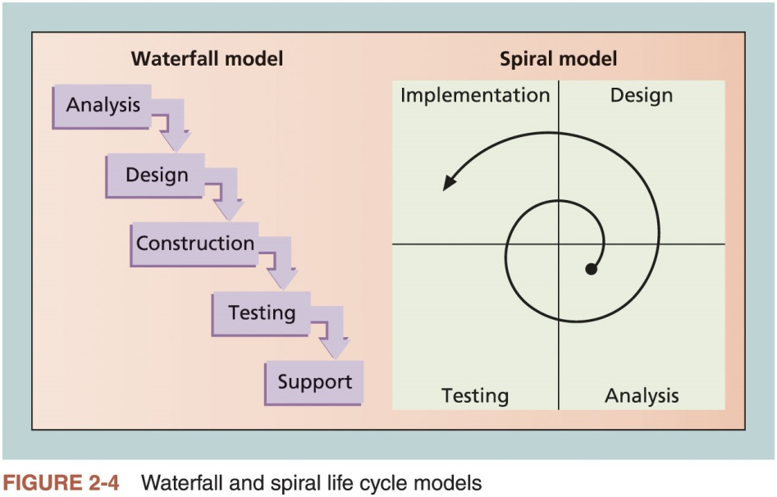
Product Life Cycles (3 of 3)

Slide 29
The Importance of Project Phases and Management Reviews
A project should successfully pass through each of the project phases in order to continue on to the next
Management reviews, also called phase exits, phase gate reviews, or kill points, should occur after each phase to evaluate the project’s progress, likely success, and continued compatibility with organizational goals
It is unwise to wait until the end of project or product phases to have management inputs
Many projects are reviewed by management on a regular basis

Slide 30
What Went Right?
"The real improvement that I saw was in our ability to⎯in the words of Thomas Edison⎯know when to stop beating a dead horse.…Edison's key to success was that he failed fairly often; but as he said, he could recognize a dead horse before it started to smell...In information technology we ride dead horses⎯failing projects⎯a long time before we give up. But what we are seeing now is that we are able to get off them; able to reduce cost overrun and time overrun. That's where the major impact came on the success rate.”*
Many organizations, like Huntington Bancshares, Inc., use an executive steering committee to help keep projects on track.
Some projects still go on a long time before being killed, like Blizzard’s Titan game project.
*Cabanis, Jeannette, "'A Major Impact': The Standish Group's Jim Johnson On Project Management and IT Project Success," PM Network, PMI, Sep.1998, p. 7

Slide 31
The Context of Information Technology Projects
Project context
Has a critical impact on which product development life cycle will be most effective for a particular software development project
Several issues unique to the IT industry have a critical impact on managing IT projects

Slide 32
The Nature of IT Projects
IT projects can be very diverse in terms of size, complexity, products produced, application area, and resource requirements
The nature of software development projects is even more diverse than hardware-oriented projects
IT projects also support every possible industry and business function

Slide 33
Characteristics of IT Project Team Members
IT project team members often have diverse backgrounds and skill sets
Many companies purposely hire graduates with degrees in other fields such as business, mathematics, or the liberal arts to provide different perspectives on IT projects
Some IT projects require the skills of people in just a few job functions
But some require inputs from many or all of them

Slide 34
Diverse Technologies
IT projects use diverse technologies that change rapidly
Differences in technical knowledge can make communication between professionals challenging
New technologies have also shortened the time frame many businesses have to develop, produce, and distribute new products and services

Slide 35
Recent Trends Affecting Information Technology Project Management
Globalization
Outsourcing: Outsourcing is when an organization acquires goods and/or sources from an outside source. Offshoring is sometimes used to describe outsourcing from another country
Virtual teams: A virtual team is a group of individuals who work across time and space using communication technologies
Agile project management

Slide 36
Globalization
Issues
Communications
Trust
Common work practices
Tools
Suggestions
Employ greater project discipline
Think globally but act locally
Consider collaboration over standardization
Keep project momentum going
Use newer tools and technology

Slide 37
Outsourcing
Organizations remain competitive by using outsourcing to their advantage, such as finding ways to reduce costs
Practice can be unpopular on some countries
Project managers should become more familiar with many global and procurement issues

Slide 38
Virtual Teams (1 of 2)
Advantages
Lowering costs because many virtual workers do not require office space or support beyond their home offices
Providing more expertise and flexibility or increasing competitiveness and responsiveness by having team members from across the globe working any time of day or night
Improving the work/life balance for team members by eliminating fixed office hours and the need to travel to work

Slide 39
Virtual Teams (2 of 2)
Disadvantages
Isolating team members
Increasing the potential for communications problems
Reducing the ability for team members to network and transfer information informally
Increasing the dependence on technology to accomplish work
See text for a list of factors that help virtual teams succeed, including team processes, trust/relationships, leadership style, and team member selection

Slide 40
Agile (1 of 2)
Agile means being able to move quickly and easily, but some people feel that project management, as they have seen it used, does not allow people to work quickly or easily
Early software development projects often used a waterfall approach
As technology and businesses became more complex, the approach was often difficult to use because requirements were unknown or continuously changing
Agile today means using an approach where requirements and solutions evolve through collaboration

Slide 41
Agile (2 of 2)
Manifesto for Agile Software Development
In February 2001, a group of 17 people that called itself the Agile Alliance developed and agreed on the Manifesto for Agile Software Development, as follows:
“We are uncovering better ways of developing software by doing it and helping others do it. Through this work we have come to value:
Individuals and interactions over processes and tools
Working software over comprehensive documentation
Customer collaboration over contract negotiation
Responding to change over following a plan”*
*Agile Manifesto.

Slide 42
Scrum (1 of 4)
According to the Scrum Alliance, Scrum is the leading agile development method for completing projects with a complex, innovative scope of work.
The term was coined in 1986 in a Harvard Business Review study that compared high-performing, cross-functional teams to the scrum formation used by rugby teams.

Slide 43
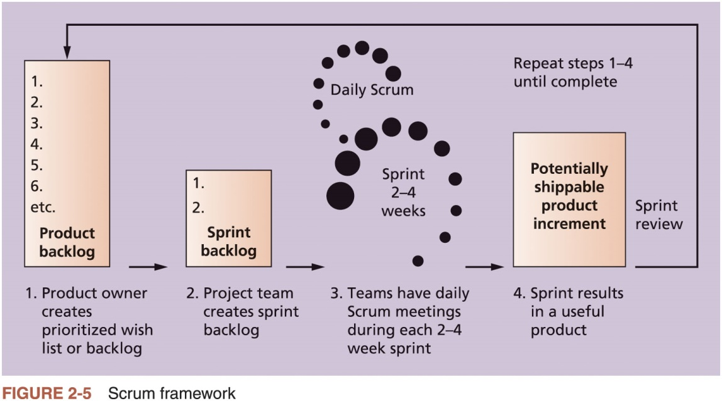
Scrum (2 of 4)

Slide 44
Scrum (3 of 4)
Kanban
Technique that can be used in conjunction with Scrum
Developed in Japan by Toyota Motor Corporation
Uses visual cues to guide workflow
Kanban cards show new work, work in progress, and work completed

Slide 45
Scrum (4 of 4)
The PMBOK® Guide describes best practices for what should be done to manage projects.
Agile is a methodology that describes how to manage projects.
The Project Management Institute (PMI) recognized the increased interest in Agile, and introduced a new certification in 2011 called Agile Certified Practitioner (ACP).
Seasoned project managers understand that they have always had the option of customizing how they run projects, but that project management is not easy, even when using Agile.

Slide 46
Chapter Summary
Project managers need to take a systems approach when working on projects
Organizations have four different frames: structural, human resources, political, and symbolic
The structure and culture of an organization have strong implications for project managers
Projects should successfully pass through each phase of the project life cycle
Project managers need to consider several factors due to the unique context of information technology projects
Recent trends affecting IT project management include globalization, outsourcing, virtual teams, and agile project management

Slide 48
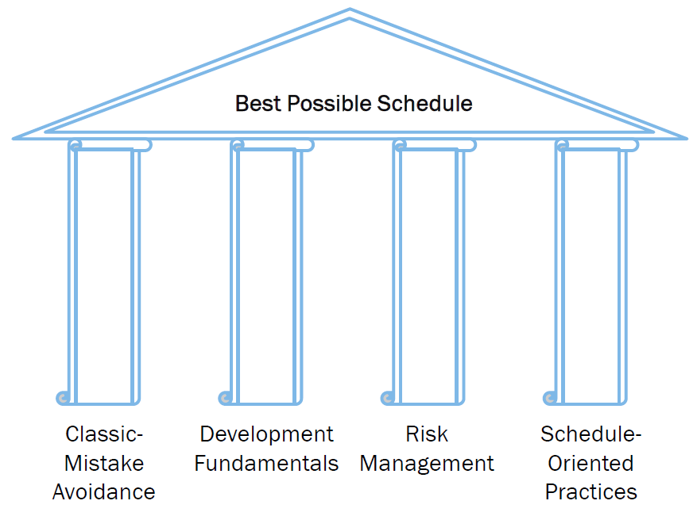
Four Pillars

Slide 49
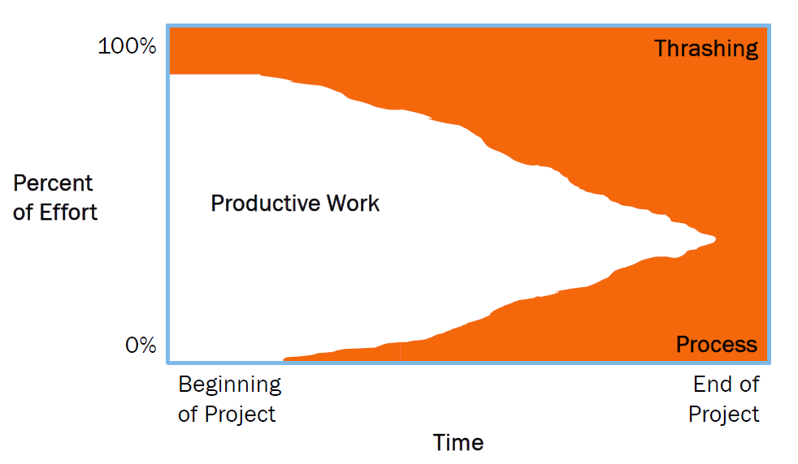
The Use of Process

Slide 50
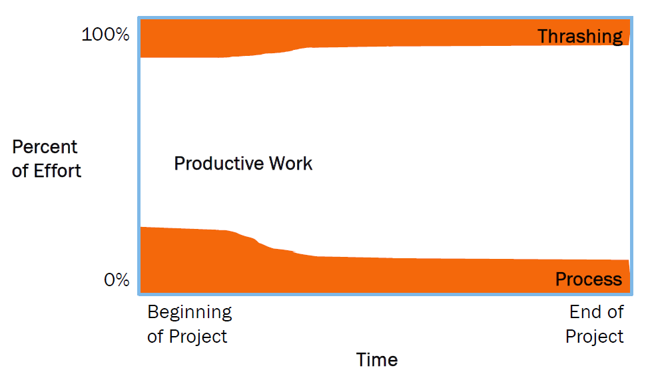
The Use of Process

Slide 51
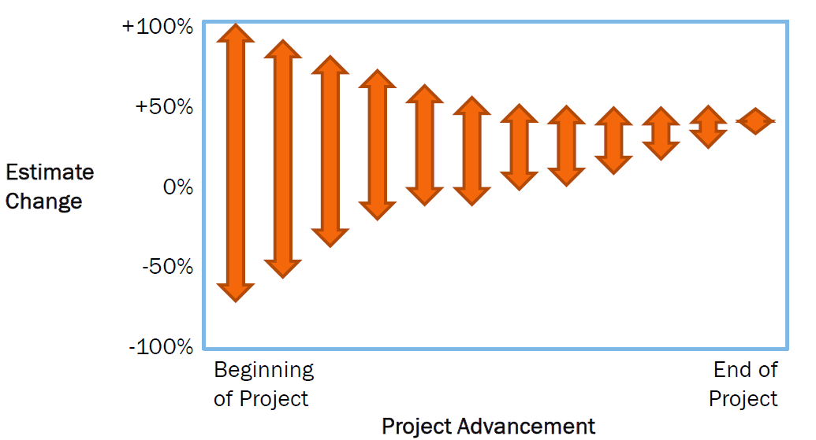
Cone of Uncertainty

Slide 54
Project Managers
Growing demand for software project managers
Organizations have become customer-driven.
Organizations have evolved from function to process structures.
Organizations are using task forces more frequently.
Organizations have become more project-oriented.
From the organization perspective, project managers are needed to:
Gain market share
Be first to market
Stay profitable
Maintain Quality

Slide 55
Project Managers
Project Managers are mainly responsible for all issues related to the software project; issues may vary depending on the project scale, some of the common issues are:
Schedule
Budget
Quality
Delivery of products
Locking in resources
Bottom line, as a project manager you will notice that most of your time is consumed chasing and collecting the status of project tasks.

Slide 56
The Field
Jobs: where are they?
Professional Organizations
Project Management Institute (PMI) (pmi.org)
The Project Management Institute (PMI) is an international professional society for project managers founded in 1969
Software Engineering Institute (SEI)
IEEE Software Engineering Group
Tools
MS Project
Notes:
monster.com search “project management”
See everything from this class
Bridge Technical and non-technical
Other Certs don’t matter
Hundreds of PM programs like MS-Project
Project: the illusion of control

Slide 57
PMI & the PMP certification
The Project Management Institute (PMI: http://www.pmi.org/) is the leading organization in advancing the project management profession
Certifications
PMI PMP
The “PMBOK” – PMI Body of Knowledge
PMI has more than 450,000 (as of 2013) members in 185 countries
Provides support in:
Education and training—seminars, program certification
Professional development and networking—Global Congresses
Professional standards and certification—standards for project-related activities (the PMBOK, scheduling, portfolios)
The Project Management Professional (PMP) certification is amongst the most valuable certifications in the IT field

Slide 58
The Field Part 2
Average Entry Level PM salary $69,000
In San Jose, an Entry Level Project Manager can make $88,568, which is 20.9% higher than the national median.
The median annual Program Manager salary is $120,195, as of March 24, 2016, with a range usually between $103,414-$138,009.
Contract rates for PM's can match techies
PMI certification adds avg. 14% to salary
PMI certificates, 1993: 1,000; 2002: 40,000; 2017: 450,000

Slide 59
The Project Manager
The Role of the Project Manager
Job descriptions vary, but most include responsibilities like planning, scheduling, coordinating, and working with people to achieve project goals
Remember that 97% of successful projects were led by experienced project managers, who can often help influence success factors
Skills for Project Managers
Project managers need a wide variety of skills
They should:
Be comfortable with change
Understand the organizations they work in and with
Be able to lead teams to accomplish project goals

Slide 60
Competencies for Project Managers
People skills
Leadership
Listening
Integrity, ethical behavior, consistent
Strong at building trust
Verbal communication
Strong at building teams
Conflict resolution, conflict management
Critical thinking, problem solving
Understands, balances priorities
Negotiating
Influencing the Organization
Mentoring
Process and technical expertise

Slide 61
Software Project Management
Fundamentals

Slide 62
Formal Project Management
Advantages of Using Formal Project Management
Better control of financial, physical, and human resources
Improved customer relations
Shorter development times
Lower costs
Higher quality and increased reliability
Higher profit margins
Improved productivity
Better internal coordination
Higher worker morale (less stress)
Less “death marches”
Less overworked personnel

Slide 63
Conventional Software Management Performance
Barry Boehm's “Industrial Software Metrics Top 10 List”:
Finding and fixing a software problem after delivery costs 100 times more than finding and fixing the problem in early design phases
You can compress software development schedules 25%, but no more
For every $1 you spend on development, you will spend $2 on maintenance
Software development and maintenance costs are primarily a function of source lines of code.
Variations among people account for the biggest difference in software productivity; hire good people to succeed.

Slide 64
Conventional Software Management Performance
Barry Boehm's “Industrial Software Metrics Top 10 List”:
The overall ratio of software to hardware costs is still growing.
Only about 15% of software development effort is devoted to programming
Software systems and products typically cost 3 times as much per SLOC as individual software programs. Software system products (system of systems) costs 9 times as much
Walkthroughs catch 60% of the errors
80% of the contributions comes from 20% of the contributors.

Slide 65
First Principles
One size does not fit all
Spectrums
Project types
Sizes
Formality and rigor
Notes:
Like families, each dysfunctional in it's own “special way”
Classic Mistakes later == Anti
Different sizes need different choices from the PM

Slide 66
Strategy
Hope is not a strategy.
So what is our strategy?
Classic Mistake Avoidance
Development Fundamentals
Risk Management
Schedule-Oriented Practices

Slide 67
PMI's 9 Knowledge Areas
Project integration management
Scope
Time
Cost
Quality
Human resource
Communications
Risk
Procurement
Notes:
If you study for the PMI certification you’ll need to know these

Slide 68
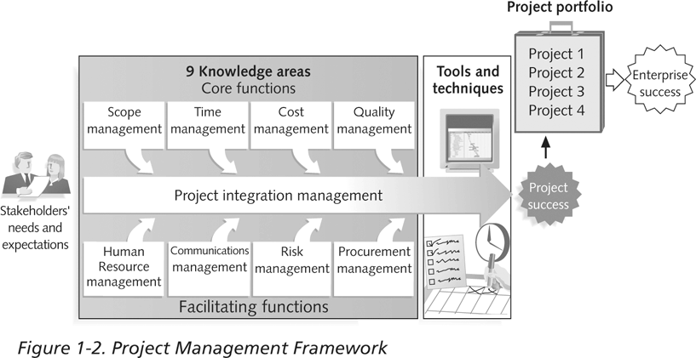
Project Management Framework

Slide 69
What is a project life cycle?
The project life cycle is a collection of sequential or overlapping project phases
The phases divide the project into logical blocks of related activities
This division into phases simplifies management, planning, and control
Phases within the project are defined by technical information transfer or technical component hand-off
Example: Inception and elaboration phases in the Unified Process
Example: Releases in Agile life cycles

Slide 70
Phases
The completion and approval of one or more deliverables (deﬁned as measurable, veriﬁable work products) deﬁnes the endpoint of a project phase
Different phases can have different relationships among themselves, even within the same project
Sequential relationship. A phase starts only when the previous phase is complete
Overlapping relationship. A new phase can be planned and started before the previous phase is complete
This class focuses on sequential phases with iterative and incremental or adaptive sub-phases

Slide 71
PMBOK project life cycles
In a predictive life cycle:
Product and deliverables are deﬁned at the beginning of the project
Changes to scope are carefully–and restrictively–managed
In an iterative and incremental life cycle:
Project phases repeat one or more project activities, taking advantage of increased understanding of the product
Each phase (and each iteration within a phase) successively adds to the functionality of the product
Scope is usually well-deﬁned early in the project life cycle, but can be changed with relatively low overhead as project proceeds
In an adaptive life cycle [Agile]:
Product is developed over multiple phases, each with several iterations
Detailed scope is deﬁned for each phase only as the phase begins

Slide 72
IT project life cycles
IT projects have two concurrent life cycles:
Project life cycle (PLC) encompasses all activities of project, including the System/Software Development Life Cycle (SDLC)
PLC is directed toward achieving project requirements
SDLC is directed toward achieving product requirements
Both life cycle models are needed to manage an IT project
PLC alone will not adequately address system development concerns
SDLC alone will not adequately address business and product integration concerns
Effective integration of the two life cycle models is essential to improving the likelihood of project success
In effect, the PLC and the SDLC should be so closely interwoven that they need not be distinguished from each other

Slide 73
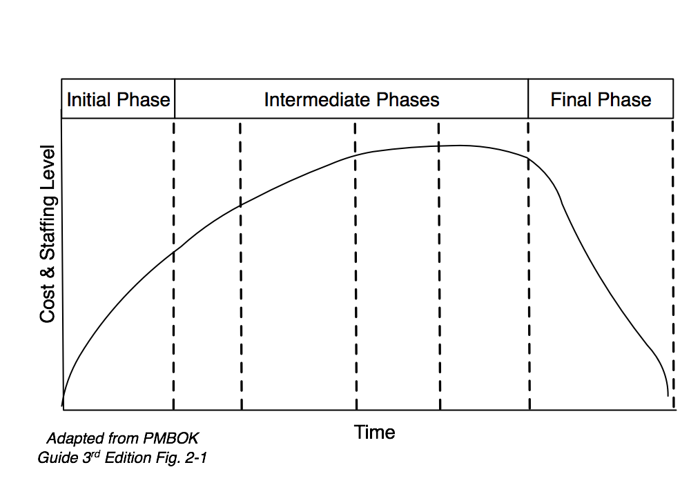
What is a project life cycle?
Consists of a number of generally sequential phases
Phases are defined by technical information transfer or technical component hand-off
Cost and staffing levels vary as a function of time according to the following qualitative schematic diagram:

Slide 74
What is a project life cycle?
Risk of failure is greatest at start of project when the level of uncertainty is highest
Stakeholder influence over project product decreases as project continues
Project life cycles define:
Technical work to be done in each phase
When deliverables are to be generated in each phase
How each deliverable is reviewed, verified, and validated
Who is involved in each phase
How to control each phase
How to approve each phase

Slide 75
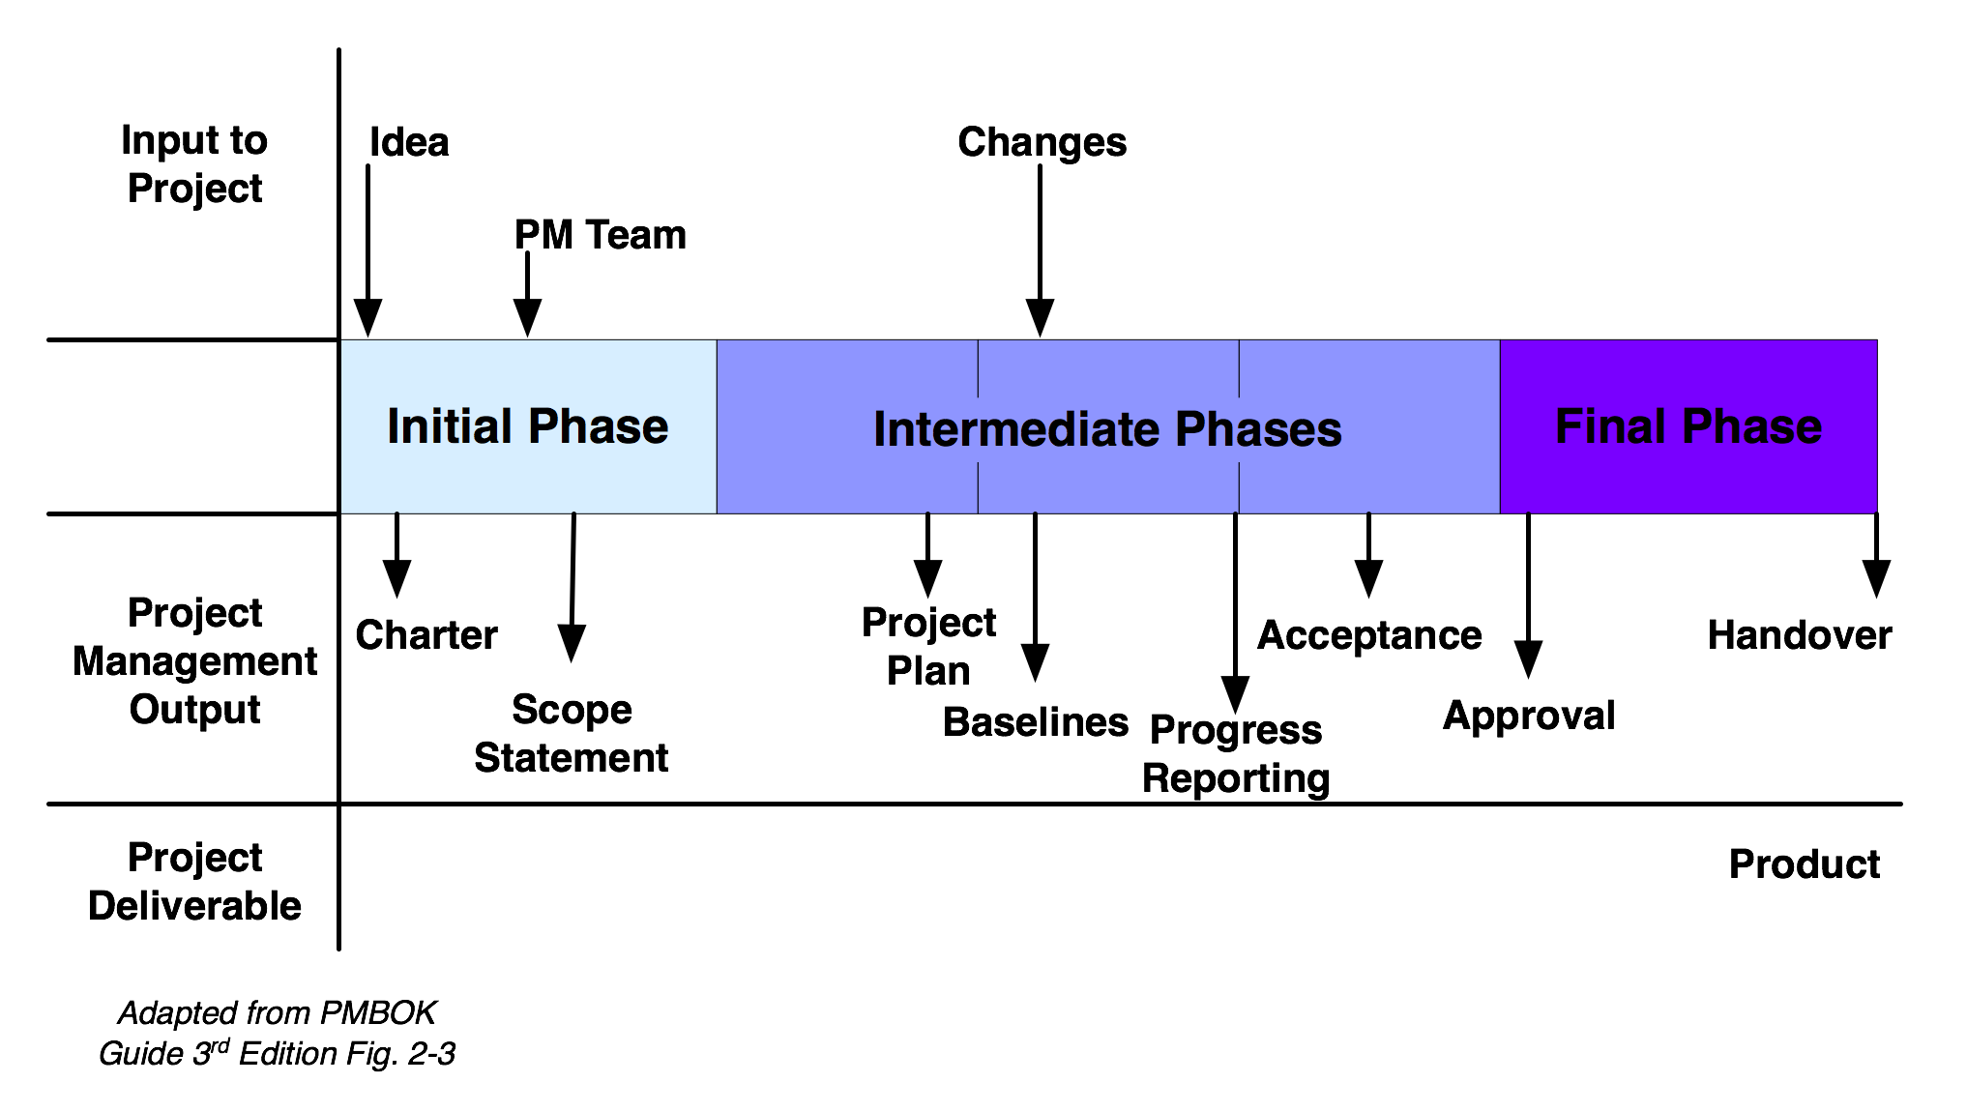
Phases in project life cycle
The completion and approval of one or more deliverables (measurable, verifiable work product) defines a project phase
In iterative systems development, new phase can be started without closing the previous phase
A phase can be closed without initiating subsequent phase

Slide 76
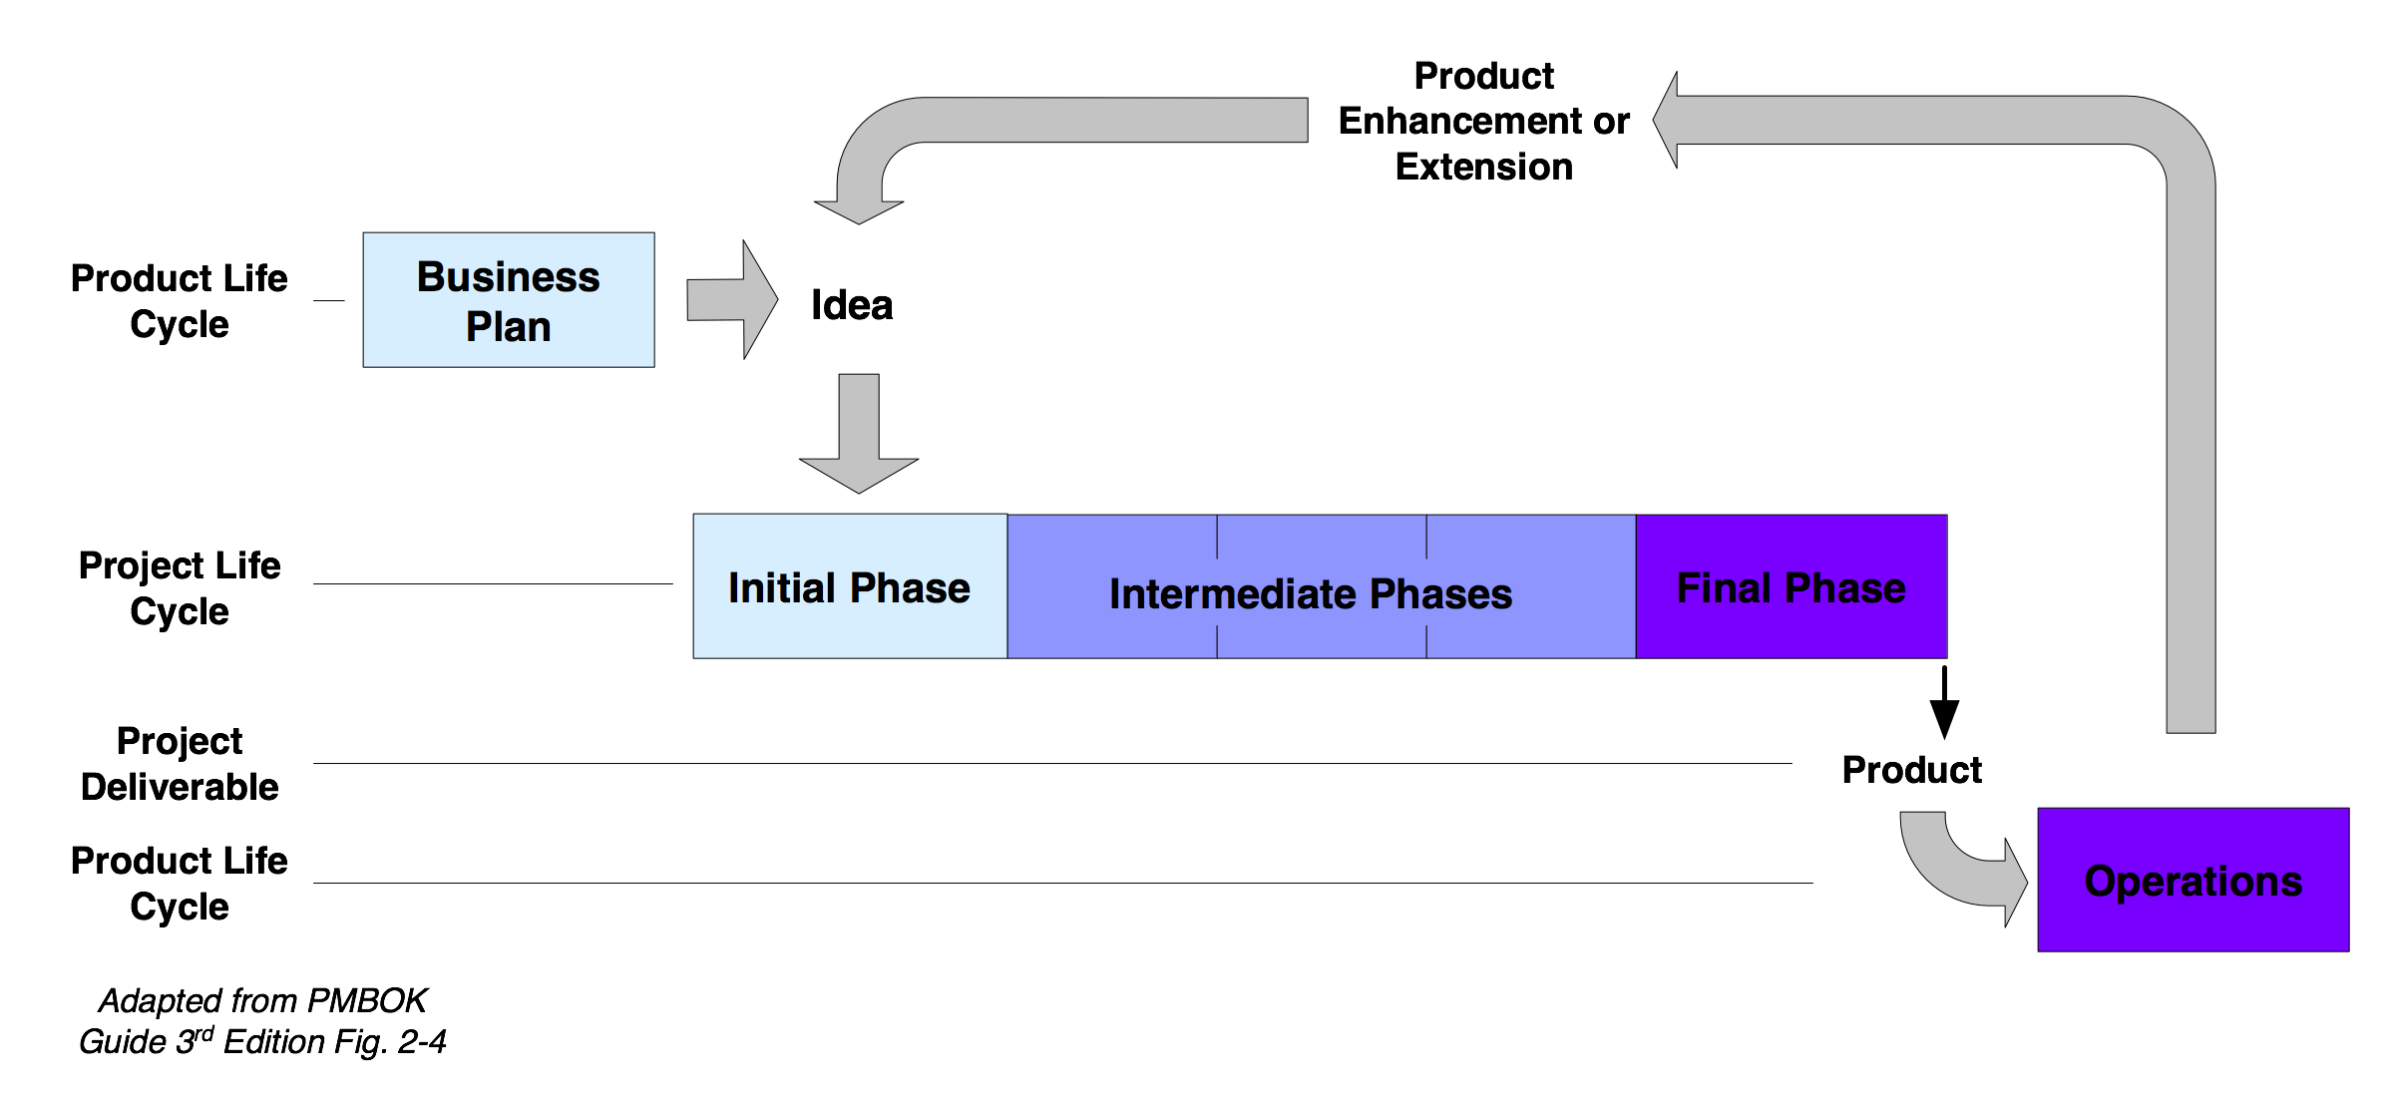
Project & product life cycles

Slide 77
The systems development lifecycle
“The systems development life cycle (SDLC) is the process of understanding how an information system (IS) can support business needs by designing a system, building it, and delivering it to users”*
A methodology is a formalized approach to implementing the SDLC
What differentiates one methodology from another:
The specific activities that must be performed
When, how, and how often the activities are performed
Who performs the activities
The amount of emphasis placed on an activity at a specific point in time
* Dennis, Alan (2012-05-01). Systems Analysis and Design with UML, 4th Edition (Page 2). Wiley. Kindle Edition.

Slide 78
Software Development Process
Ad hoc
Code and Fix
Rapid Prototyping
Prescriptive
Linear/sequential (Classic and Waterfall)
Evolutionary (Iterative/incremental or spiral)
Unified Process
Adaptive
Lean and agile methods
Notes:
SE 425
April 3, 2008
Lecture 1
78/85
SE 425
April 3, 2008
Lecture 1
78/108
Lecture 1
January 8, 2008
SE 425
78/108

Slide 79
Sequential (‘waterfall’) methodology
The term waterfall was coined by Winston Royce in a 1970 paper titled Managing the Development of Large Software Systems, in the Proceedings of IEEE WESCON
The paper used the sequential waterfall approach as an example of an ill-conceived, risk-prone practice for developing large systems
Royce advocated a series of iterative feedback loops among the development stages, incrementally gaining learning value from working software
Instead of adopting the approach Royce advocated, managers and practitioners adopted its anti-form, without feedback loops

Slide 80
Waterfall SDLC
Each phase is marked by completion of Deliverables
The primary software project phases:
Requirements
Analysis
Design
Construction
Quality Assurance (aka Testing)
Deployment

Slide 81
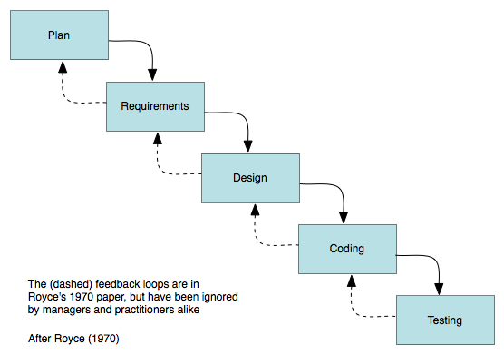
Waterfall SDLC

Slide 82
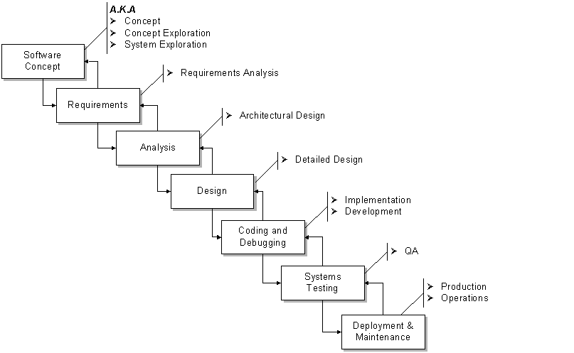
Project Phases A.K.A.

Slide 83
Waterfall system development model
Highly-sequential process
Failure symptoms:
Protracted integration and late design breakage
Late risk resolution
Requirements-driven functional decomposition
Adversarial stakeholder relationships
Focus on documents and review meetings
Still followed (in name or practice) by many organizations, usually a modified version

Slide 84
Waterfall system development model
Sequential: suitable projects and management approaches
A sequential SDLC is suitable for projects with:
Clear, unambiguous, and stable user requirements
Familiar, proven technology
Low complexity
Adequate time
Stable schedule
A project meeting most of these criteria can use conventional project management practices, such a big, up-front planning and conventional risk assessment

Slide 85
Evolutionary methodologies
An evolutionary methodology follows an iterative and incremental approach that allows the start of development with incomplete, imperfect knowledge
An iterative and incremental process is like solving a jigsaw puzzle: neither top-down nor bottom-up but accretionary and convergent
An iterative and incremental process offers these advantages:
Logical progress toward evolving a robust architecture
Effective management of changing requirements
Effective means to address changes in planning
Ability to perform continuous integration
Early understanding of the system (the ‘Hello world!’ effect)
Ongoing risk assessment
Evolutionary methodologies are incremental at both the macro (project- scale) and micro (working team) process levels

Slide 86
Iterative system development model
Non-linear approach to system development
Incorporates top five principles of modern development processes:
Architecture first. Provides the central design element
Iterative life-cycle process. Provides the essential risk management element
Component-based development. Provides the technology element
Change management environment. Provides the control element
Round-trip engineering. Provides the automation element

Slide 87

5,000 foot view of Iterative SDLC
Iterative SD model defines four life-cycle phases:
Inception
Elaboration
Construction
Transition
We iterate through each phase, and repeat as needed.
Now, for a quick survey of the phases…

Slide 88
Inception phase
Essential activities
Formulate product scope. Capture requirements and operational concept
Perform feasibility analysis. Determine whether the organization has the resources and technical capabilities to meet customer's needs
Synthesize the system architecture. Evaluate essential system design constraints and trade-offs, as well as available solutions
Plan and prepare business case. Address risk management, staffing, iteration plans, cost, and infrastructure

Slide 89
Elaboration phase
Most critical phase of the four
Essential activities
Elaborate the vision. Detail elements of the vision that drive architectural or planning decisions
Elaborate the process and infrastructure. The construction process and environment are established here
Elaborate the architecture and select reusable (internal or COTS) components. Baseline the architecture as quickly as possible and demonstrate that the architecture will support the vision at reasonable cost in reasonable time

Slide 90
Construction phase
Essential activities
Achieve useful versions (intermediate, alpha, beta, and other test releases)
Perform resource management, control, and process optimization
Complete component development and test
Assess product releases against acceptance criteria

Slide 91
Transition phase
Essential activities
Perform deployment-specific engineering tasks. Commercial packaging and production, sales kit development, field personnel training
Assess deployment baselines against complete vision and acceptance criteria. Examine and compare what is being delivered to what was envisioned and delineated by acceptance criteria
Plan for next iteration

Slide 92
Comparative expenditure profiles
Waterfall |  | Iterative
Activity | Cost | Cost | Activity
Management | 5% | 10% | Management
Requirements | 5% | 10% | Requirements
Design | 10% | 15% | Design
Code & Unit Testing | 30% | 25% | Implementation
Integration & Test | 40% | 25% | Assessment
Deployment | 5% | 5% | Deployment
Environment | 5% | 10% | Environment
Total | 100% | 100% | Total
Based on and adapted from Tables 1-1 and 10-1 in
Software Project Management: A Unified Approach by Walker Royce

Slide 93
Suitable Projects And Management Approaches
An evolutionary SDLC is suitable for projects with:
Reasonably–but not perfectly–clear user requirements
Unfamiliar or unproven technology
High complexity
Short time schedule
Schedule variability
Such a project would use rolling wave planning rather than big, up-front planning and use a continuous, adaptive approach to risk assessment and management

Slide 94
Agile Project Management

Slide 95
Agile Projects
Lean methodology. Only as much process as necessary.
'Agile' is an umbrella term used for identifying various models used for agile development, such as Scrum.
Since agile development model is different from conventional models, agile project management is a specialized area in project management.

Slide 96
Agile Projects
Agile project management is an iterative approach to planning and guiding project processes.
An agile project is completed in small sections called iterations, or, in scrum, sprints.
Each iteration is reviewed and critiqued by the project team, which may include representatives of the client business as well as employees.
Insights gained from the critique of an iteration are used to determine what the next step should be in the project.
Each project iteration is typically scheduled to be completed within two weeks.
Notes:
http://searchcio.techtarget.com/definition/Agile-project-management

Slide 97
Agile Project Steps
The product owner identifies the product vision.
The product owner creates a product roadmap.
The product owner creates a release plan.
The product owner, the (scrum) master, and the development team plan sprints, also called iterations, and start creating the product within those sprints
During each sprint, the development team has daily meetings [called scrums].
The team holds a sprint review.
The team holds a sprint retrospective.
Notes:
http://www.dummies.com/how-to/content/agile-project-management-for-dummies-cheat-sheet.navId-410850.html

Slide 98
Agile Project Artifacts
Product vision statement: An elevator pitch, or a quick summary, to communicate how your product supports the company's or organization's strategies. The vision statement must articulate the goals for the product. Revisit once a year.
Product roadmap: The product roadmap is a high-level view of the product requirements, with a loose time frame for when you will develop those requirements. Revisit twice a year.
Release plan: A high-level timetable for the release of working software.
Product backlog: The full list of what is in the scope for your project, ordered by priority. Once you have your first requirement, you have a product backlog.
Sprint backlog: The goal, user stories, and tasks associated with the current sprint.
Increment: The working product functionality at the end of each sprint.
Notes:
http://www.dummies.com/how-to/content/agile-project-management-for-dummies-cheat-sheet.navId-410850.html

Slide 99
Agile Project Roles
Development team: The group of people who do the work of creating a product. Programmers, testers, designers, writers, and anyone else who has a hands-on role in product development is a member of the development team.
Product owner: The person responsible for bridging the gap between the customer, business stakeholders, and the development team. The product owner is sometimes called a customer representative.
Scrum master: The person responsible for supporting the development team, clearing organizational roadblocks, and keeping the agile process consistent. A scrum master is sometimes called a project facilitator.
Stakeholders: Anyone with an interest in the project.
Agile mentor: Someone who has experience implementing agile projects and can share that experience with a project team. The agile mentor can provide valuable feedback and advice to new project teams and to project teams that want to perform at a higher level.
Notes:
http://www.dummies.com/how-to/content/agile-project-management-for-dummies-cheat-sheet.navId-410850.html

Slide 100
Agile Project Events
Project planning: The initial planning for your project.
includes creating a product vision statement and a product roadmap,
can take place in as little time as one day.
Release planning: Planning the next set of product features to release
Sprint: A short cycle of development, in which the team creates potentially shippable product functionality.
Sprint planning: A meeting at the beginning of each sprint where the scrum team commits to a sprint goal.
Daily scrum: A 15-minute meeting held each day in a sprint, where development team members state what they completed the day before, what they will complete on the current day, and whether they have any roadblocks.
Notes:
http://www.dummies.com/how-to/content/agile-project-management-for-dummies-cheat-sheet.navId-410850.html

Slide 101
Agile Project Events
Sprint review: A meeting at the end of each sprint, where the development team demonstrates the working product functionality it completed during the sprint.
Sprint retrospective: A meeting at the end of each sprint where the scrum team discusses what went well, what could change, and how to make any changes.
Notes:
http://www.dummies.com/how-to/content/agile-project-management-for-dummies-cheat-sheet.navId-410850.html

Slide 102
Selection considerations: guiding questions
Organizational characteristics
What are the characteristics of the organizational culture? What are the management comfort levels with the various methodologies?
How open is management and the organization to change?
Is the organization risk-tolerant or risk-adverse?
What is the organization's tolerance for real risk vs. perceived risk?
Project characteristics
How large is the project?
What is the project's estimated duration?
Are teams co-located or distributed?
Is regulatory compliance a signiﬁcant factor?
How ﬂexible are documentation requirements?

Slide 103
Selection considerations: guiding questions
People and management characteristics
What are the experience levels of team members?
Are team members self-motivated or command-driven?
What sort of management style is employed? Laissez-faire, micromanagement, or somewhere in-between?
What sort of social dynamics govern project efforts within the organization? Cooperative and problem-solving, adversarial, or blaming?

Slide 104
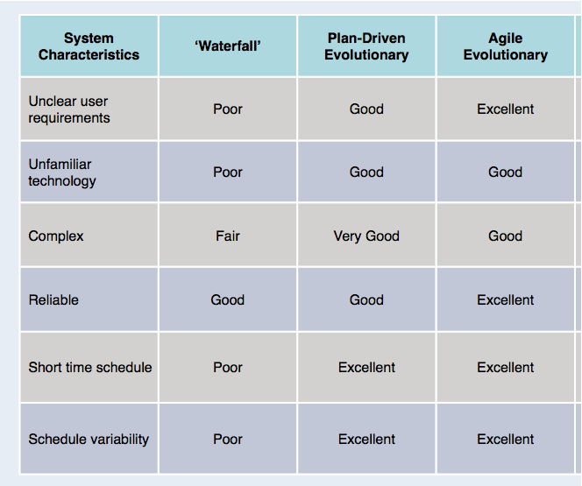
Methodology characteristics compared

Slide 105
Examples: Applying the table
Short time schedule + shifting user requirements
Agile
Complex + short time schedule
Iterative
Clear user requirements + long time schedule + command-driven team
Water-fall
Reliable + complex + schedule variability
Agile
Unfamiliar technology + short time schedule + schedule variability
Either Agile or Iterative

Slide 106
Software Project Management
Project organization
Putting a process in place
Software process
Phases for software project management

Slide 107
Process
A process encapsulates an organization's experience in form of successful recipes.
Process descriptions, generally, contain the sequence of steps to be executed, who executes them, the entry/exit criteria for major steps, etc.
Guidelines, checklists, and templates provide support to use the processes.
Processes
Checklists
Guidelines
Templates
Activity
Review

Slide 108
Putting a Process in Place
Choosing a Process.
All projects have a process, unfortunately some don’t specify and implement their process.
Projects with no specified process end up thrashing.
Thrashing, unproductive work, can quickly cripple a project.
Generally, there are two choices for choosing a process:
Tailor the organizational process to your project.
Used when most of the people are from the same group as before
Used when the last project was successful.
Specify a process for your project.
Good when people are from different organizations using different processes

Slide 109
Tailoring a Process
Steps to Tailoring an Organizational Process:
Determine how your project differs from the typical organizational project.
Form two lists: activities your project needs from the organizational process and tasks your project doesn’t need from the process
Propose changes to the organizational process
Circulate the tailored process within the team and other key personnel for review and input.
Integrate the changes and move quickly for closure.

Slide 110
Assessing the Process
Assessing should be an ongoing process through out the project.
Both the project and the process should lend themselves to assessment and improvement.
Make gathering measurements part of concurrent documentation.
Gather data to answer the following:
Were the tasks and supporting activities effective?
How much effort did each task and activity require?
What tasks and activities were performed but weren’t in the process specification?
How did the products change over time?
When did tasks and activities start and stop?
How did tasks and activities integrate?
When in the project did we spend effort doing what?
Repeat this during project close out.

Slide 111
The Project Manager: Responsibilities
Project planning
Managing the project
Lead project team
Building client partnerships
Targeting to the business

Slide 112
Few Rules Before We Embark
And finally, communicate, communicate, and communicate!
people in a
conference room with whiteboard
people
on Video
Conferencing
Communication Effectiveness
phone
Videotape
Paper
email
Richness of communication channel

Slide 113
Recap
Definition of a Project
A project is a sequence of unique, complex, and connected activities having one goal or purpose and that must be completed by a specific time, within budget, and according to specification.
What is a Program?
A program is a collection of projects.
The projects must be completed in a specific order for the program to be considered complete. Because they compromise multiple projects, they are larger in scope than a single project.

Slide 114
Project Parameters
Five constraints operate on every project:
Scope
Quality
Cost
Time
Resources
A change in one of these constraints can cause a change in another constraint to restore the equilibrium of the project
Let's discuss each one of these in detail …

Slide 115
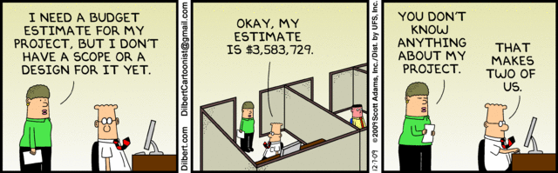
Scope

Slide 116
Project Parameters
Scope
Scope is a statement that defines the boundaries of the project. It tells not only what will be done but also what will not be done.
In the information systems industry, scope is often referred to as a functional specification.
In the engineering profession, it is generally called a statement of work.
Quality
Two types of quality are part of every project:
The first is product quality. This refers to the quality of the deliverable form of the project.
The second type of quality is process quality, which is the quality of the project management itself. The focus is on how well the project management process works and how can it be improved. Continuous quality improvement and process quality management are the tools used to measure process quality.

Slide 117
Project Parameters
Cost – The X-amount of dollars that it will cost to do the project is another variable that defines the project; the budget that has been established for the project.
This is an important factor for projects that create deliverables that are sold to external customers
Time – The customer specifies a timeframe within which the project must be completed.
Cost and time are inversely related to one another. The time a project takes to be completed can be reduced, but cost increases as a result.
Resources – Resources are assets, such as people, equipment, physical facilities, or inventory, that have limited availabilities, can be scheduled, or can leased from an outside party. Some are fixed, others are variable only in the long term. In any case, they are central to the scheduling of project activities and the orderly completion of the project.

Slide 118
5,000 foot view of PM processes
PMBOK Guide collects the forty-four defined PM processes into five Project Management Process Groups
Initiating
Planning
Executing
Monitoring & Controlling
Closing
Now, we’ll take a quick survey of the processes in each group …

Slide 119
Phases of the Project Management
There are five phases of the project management life cycle:
Scope/Define/Initiate – Scope the project
Plan – Develop the project plan
Execute – Launch the plan
Monitor – Monitor/control project progress
Close – Close out the project
Note: these can be repeated for each phase
Each process/phase/activity is described by:
Inputs
Tools & Techniques
Outputs
Notes:
projects are composed of processes

Slide 120
Initiating Process
Develop project charter
State the problem/opportunity.
Concerned with authorizing a project
May be used for a whole project
May be used for a single project phase in a large, multiphase project
Develop preliminary project scope statement
Concerned with producing a preliminary, high-level definition of project
Broadly defines what is and what is not part of the project
Establish the project plan.
Define the project objectives.
Identify the success criteria.
List assumptions, risks, obstacles

Slide 121
Initiating Process
Inputs
Product Description
Strategic plan
Project Selection Criteria
Historical Information
Outputs
Project Charter
Project Manager assigned
Constraints
Assumptions

Slide 122
Planning Process
Devising and maintaining a workable scheme to accomplish the business need that the project was undertaken to address
Scope Planning
Scope Definition
Activity Definition
Activity Sequencing
Activity Duration Estimating
Resource Planning
Cost Estimating
Cost Budgeting
Schedule Development
Quality Planning
Communications Planning
Organization Planning
Staff Acquisition
Risk Planning
Procurement Planning
Project Plan Development

Slide 123
Develop the project plan
Develop project management plan
Concerned with creating and integrating all sub-plans into a single source of information
Identify the project activities.
Scope planning
Concerned with how the project scope statement will be created
Create WBS
Scope definition
Concerned with actual creation of project scope statement
Activity definition
Activity sequencing
Activity duration estimating
Activity resource estimating
Determine resource requirements.

Slide 124
Planning processes
Schedule development
Concerned with analyzing activity outputs (definition, etc.) to create project schedule
Construct/analyze the project network.
Cost estimating **
Cost budgeting
Concerned with aggregating costs of individual activities to establish cost baseline
Quality planning *
Concerned with quality standards and how to achieve them
Human resource planning *
Communications planning *
* indicates minimal or no coverage
^{** indicates optional} ^{coverage}

Slide 125
Planning processes
Risk management planning
Concerned with how to carry out risk management activities
Risk identification
Qualitative risk analysis
Concerned with prioritizing risks based on probability of occurrence and impact
Quantitative risk analysis *
Risk response planning
Concerned with mitigating risks to project objectives
Plan purchases and acquisitions *
Concerned with what, when, and how of purchases and acquisitions
Plan contracting *
Prepare the project proposal.

Slide 126
Executing Process
Coordinating people and other resources to carry out the plan
Project Plan Execution
Scope Verification
Quality Assurance
Acquire project team
Identify and organize the project team.
Establish team operating rules.
Team Development
Solicitation
Information Distribution
Source Selection
Contract Administration
Level project resources.
Schedule work packages.
Document work packages.
Notes:
Direct and manage project execution
Concerned with directing technical and organizational entities to execute work defined in PM plan
Perform quality assurance
Concerned with applying planned quality activities
Acquire project team
Develop project team
Concerned with improving competencies and interaction of project members
Information distribution *
Request seller responses *
Select sellers *

Slide 127
Monitoring & Controlling Process
Monitor and control project work
Ensuring that project objectives are met by monitoring and measuring progress and taking corrective measures when necessary
Concerned with acquiring and assessing performance information to effect process improvements
Integrated change control
Overall Change Control
Scope Change Control
Schedule Control
Scope control – Concerned with changes to project scope
Scope verification – Concerned with acceptance of project deliverables
Schedule control – Concerned with changes to project schedule

Slide 128
Monitoring & Controlling Process
Cost control * – Concerned with changes to the project budget
Quality Control – Concerned with monitoring quality compliance of project results and correcting unsatisfactory results
Manage project team – Concerned with tracking performance, providing feedback, and coordinating changes
Define problem-escalation process.
Monitor project progress versus plan.
Establish progress reporting systems.
Performance reporting * – Concerned with status, progress, and forecasting
Install change control tools/process.
Risk monitoring and control
Manage stakeholders
Contract administration *
Revise project plans.

Slide 129
Close out the project
Formalizing acceptance of the project or phase and bringing it to an orderly end
Administrative Closure
Concerned with finalizing all activities across all Process Groups
Complete project documentation.
Complete post-implementation audit.
Lessons learned
Issues final project report.
Contract Close-out
Concerned with completing and settling all contracts
Obtain client acceptance.
Install project deliverables.

Slide 130
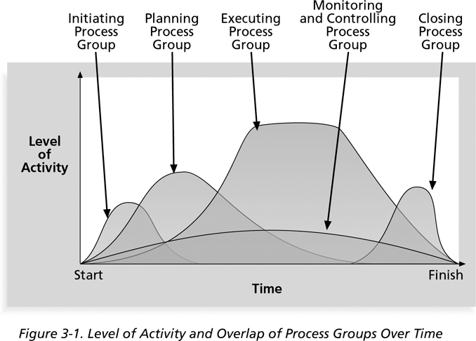
Phases of the Project Management
Level of Activity and Overlap of Process Groups Over Time

Slide 131
Project Processes & Their Integration
Project Management Processes (Principles of Project Management)
Initiating processes (Defining)
Planning processes
Executing processes
Monitoring & controlling processes
Closing processes
System Development Processes (Iterative/evolutionary)
Inception phase
Elaboration phase
Construction phase
Transition phase
Integrating IT Project Processes
PM/IT project integration tactics

Slide 132
PM/IT process integration tactics
Wherever possible, establish common policies, processes, and procedures between IT and PM groups
Identify an integration manager to link IT and PM groups
Use a common, integrated, consistent vocabulary that is continuously updated to facilitate inter- (as well as intra-) group communications
Ensure that project manager possesses suitable process integration skills and is familiar with IT risks
Involve IT analysts in development of business requirements
Identify an ombudsman to quickly resolve issues that arise between PM and IT groups

Slide 133
Project & SDLC integration waterfall development model
Deployment
Waterfall SDLC Phases
Concept
Requirements
Design
Code & Unit Testing
Integration & Test
Initiating
Planning
Executing
Closing
Monitoring & Controlling
PM Process Groups

Slide 134
Phases in iterative* system life cycle
The stages below are repeated (iterative) – see notes
Engineering Stage
Production Stage
Inception
Elaboration
Construction
Transition
Phases
Establish the
ability to
build the system
within
constraints
Build the
intermediate
internal releases
of the
system
Roll out a fully-
functional
system to the
customer
Establish that the
system is viable
Product
Idea
Architecture
Intermediate
Releases
* I often interchange iterative & evolutionary
Notes:
In an iterative development the four phases (Inception, Elaboration, Construction and Transition) are repeated iteratively. Each time they add features to the product. There is also a phase where there is more planning.

Slide 135
Project & SDLC integration iterative/incremental development model
Engineering Stage
Production Stage
Inception
Elaboration
Construction
Transition
Establish the
ability to
build the system
within
constraints
Build the
intermediate
internal releases
of the
system
Roll out a fully-
functional
system to the
customer
Establish that the
system is viable
Initiating
Planning
Executing
Closing
Monitoring & Controlling
PM Process Groups
Product
Idea
Architecture
Intermediate
Releases
Objectives
Milestone
Architecture
Milestone
Initial Operational
Capability Milestone
Product
Release
Milestone
Notes:
In an iterative development the four phases (Inception, Elaboration, Construction and Transition) are repeated iteratively. Each time they add features to the product. There is also a phase where there is more planning.
In each iteration we plan for the next iteration.

Slide 136
Project & SDLC integration iterative development model
Planning in the iterative development model
Needs to take into consideration the iterations
See PMBOK-SWE Ch. 2.4.2.3
See also: Kruchten, P (2002, Oct 15) Planning an Iterative Project: http://www.ibm.com/developerworks/rational/library/2831.html

Slide 137
Project Management Tools

Slide 138
Project Management Tools
There are many tools available
MS-Project is an example of these tools
Basic requirements
Develop a Work Breakdown Structure
Build network diagram (aka PERT chart)
Build Gantt chart
Assign resources
Calculate critical path and critical chain
What is the difference between critical path and critical chain?
Critical chain also manages buffer activity durations and resources

Slide 139
PM Tools: Software
Low-end
Basic features, tasks management, charting
MS Excel, Milestones Simplicity
Mid-market
Handle larger projects, multiple projects, analysis tools
MS Project (approx. 50% of market)
High-end
Very large projects, specialized needs, enterprise
AMS Realtime
Primavera Project Manager

Slide 140
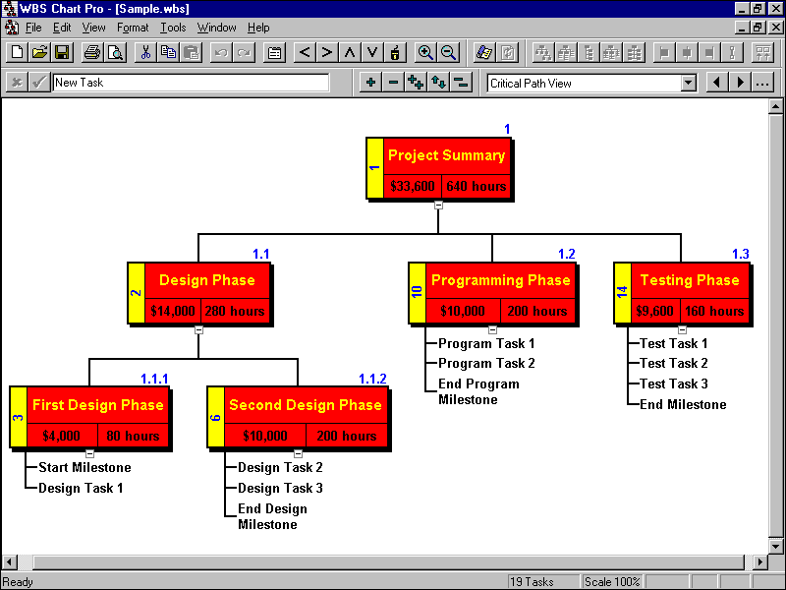
Work Breakdown Structure
Breaks project into a hierarchy.
Creates a clear project structure.
Avoids risk of missing project elements.
Enables clarity of high level planning.

Slide 141
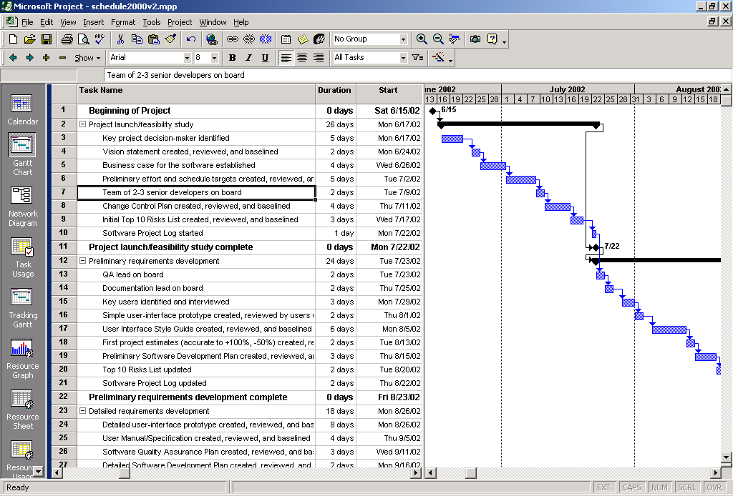
Tools: Gantt Chart

Slide 142
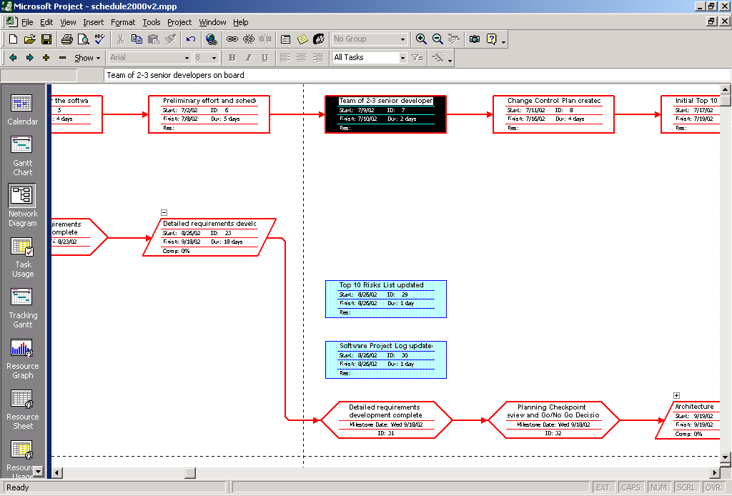
Tools: Network Diagram

